Slide 1


FLIPKART SMART TV’S
TV DATASET DASHBOARD
Review: Enabling Data-Driven Decisions
Facilitating quick operational decisions through upto 2025 TV market data analysis

Slide 2



ABOUT ME
NAME -- NAGARJUNA REDDDY
BACKGROUND -- B.TECH (CSE)
WORK EXPERIENCE -- FRESHER
WHY I WANT TO LEARN DATA SCIENCE --
LINKEDIN --
DATA SCIENCE OFFERS GREAT CAREER PROSPECTS. THE DEMAND FOR SKILLED PROFESSIONALS IS HIGH
Linkedin.com/in/annapureddy-nagarjunareddy-1273b2282/

Slide 3
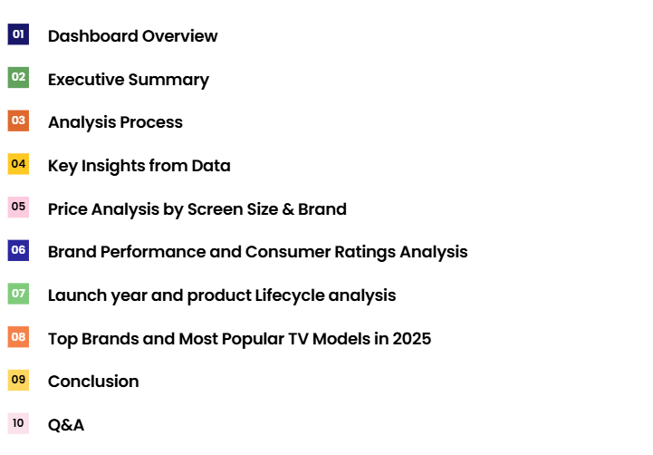
Agenda

Slide 4
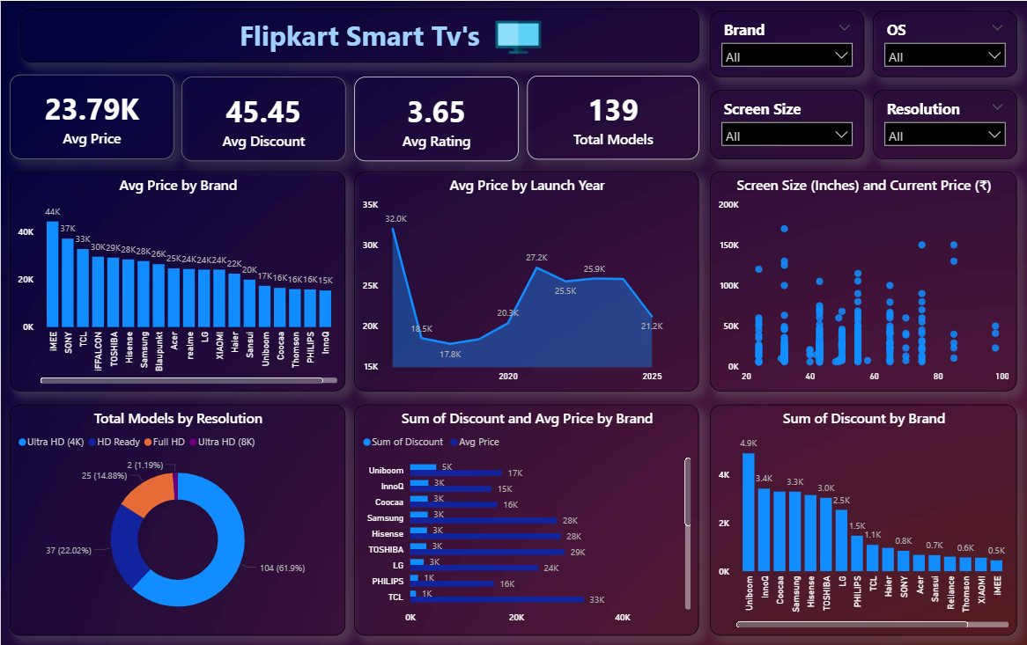
Dashboard Overview

Slide 5
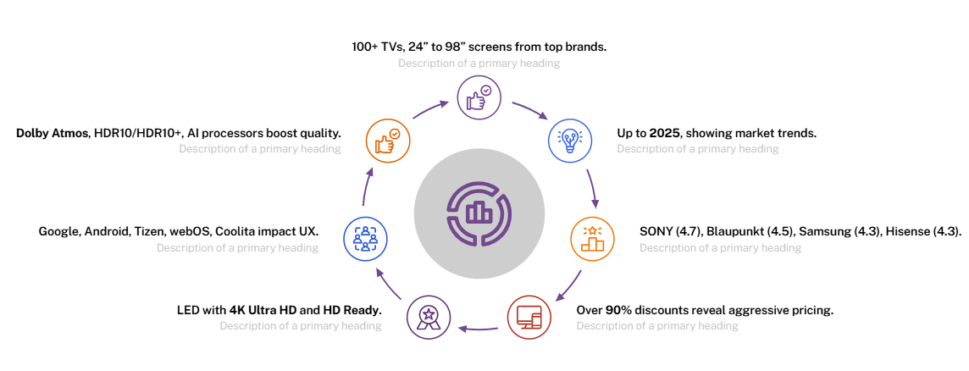
Executive Summary
Key Market Insights and Strategic Highlights

Slide 6
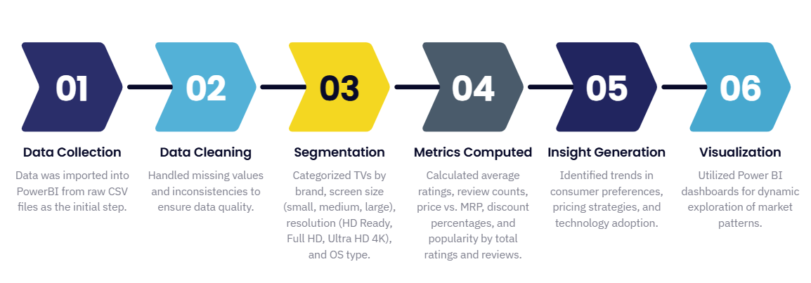
Analysis Process
From Raw Data to Actionable Insights

Slide 7
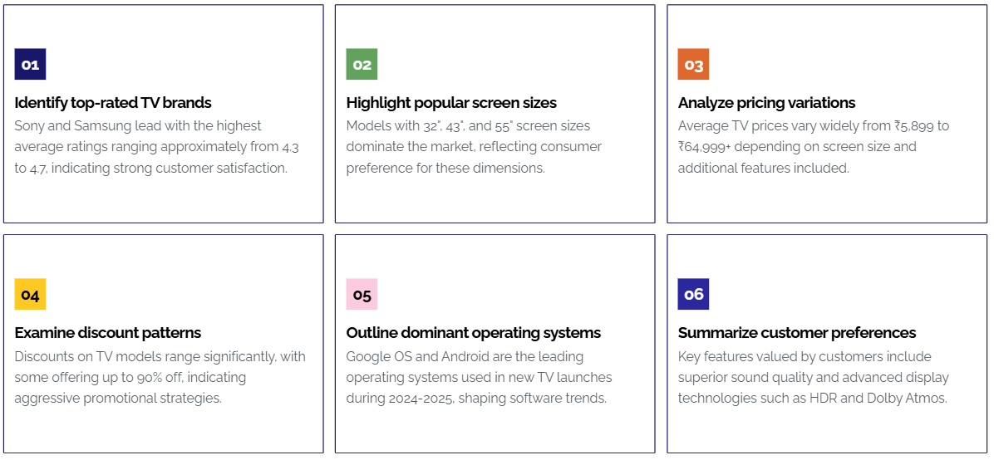
Key Insights from Data

Slide 8
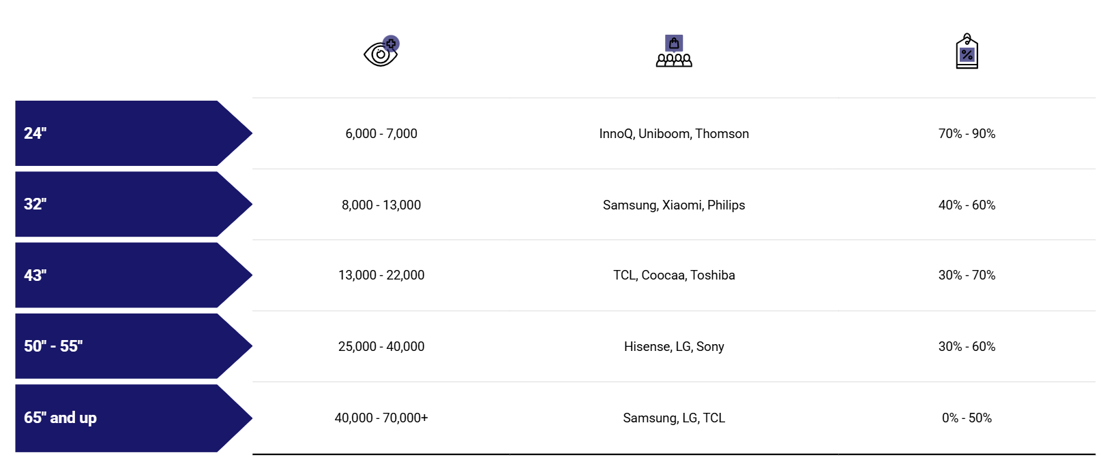
Price Analysis by Screen Size & Brand
Price ranges and discount impact across various TV’S & TV screen sizes

Slide 9
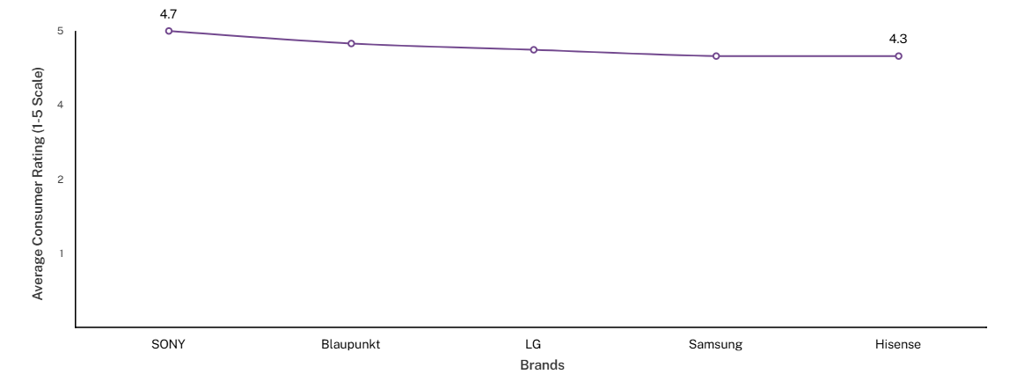
Brand Performance and Consumer Ratings Analysis
Insights on brand ratings, review volumes, and pricing impact on consumer satisfaction
Top Brands by Average Consumer Rating

Slide 10

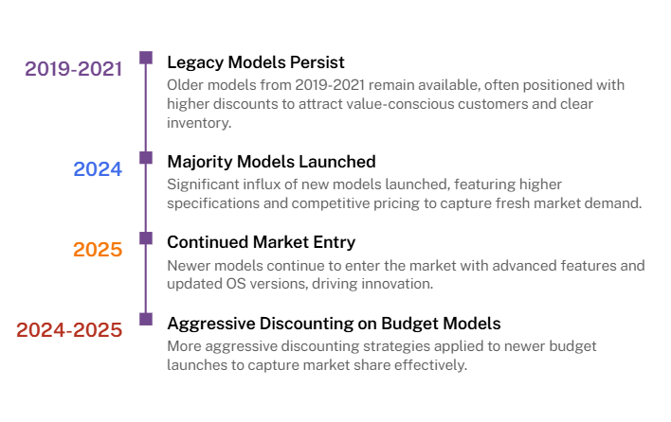

Slide 11
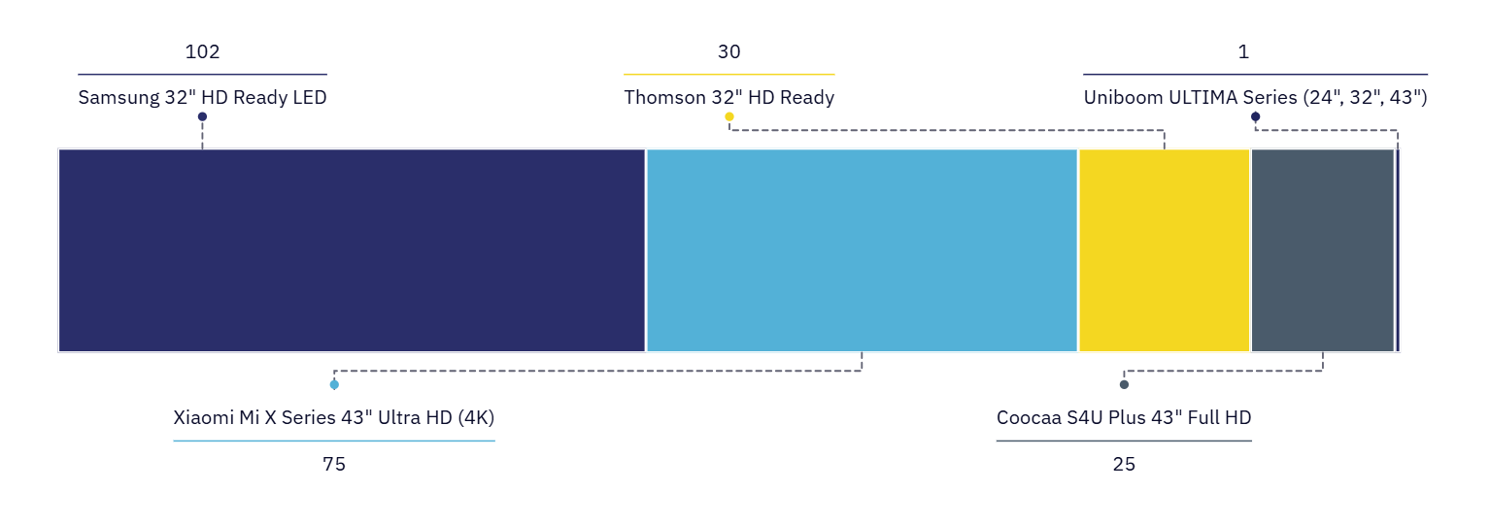
Top Brands and Most Popular TV Models in 2025
Leading TV brands, model ratings and consumer preferences analysis
Most Popular TV Models by Total Ratings in 2025

Slide 12
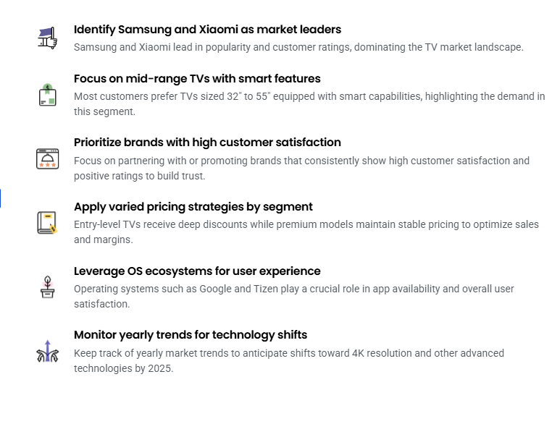

Conclusion

Slide 13


Q&A

Slide 14


THANK YOU

